Slide 1
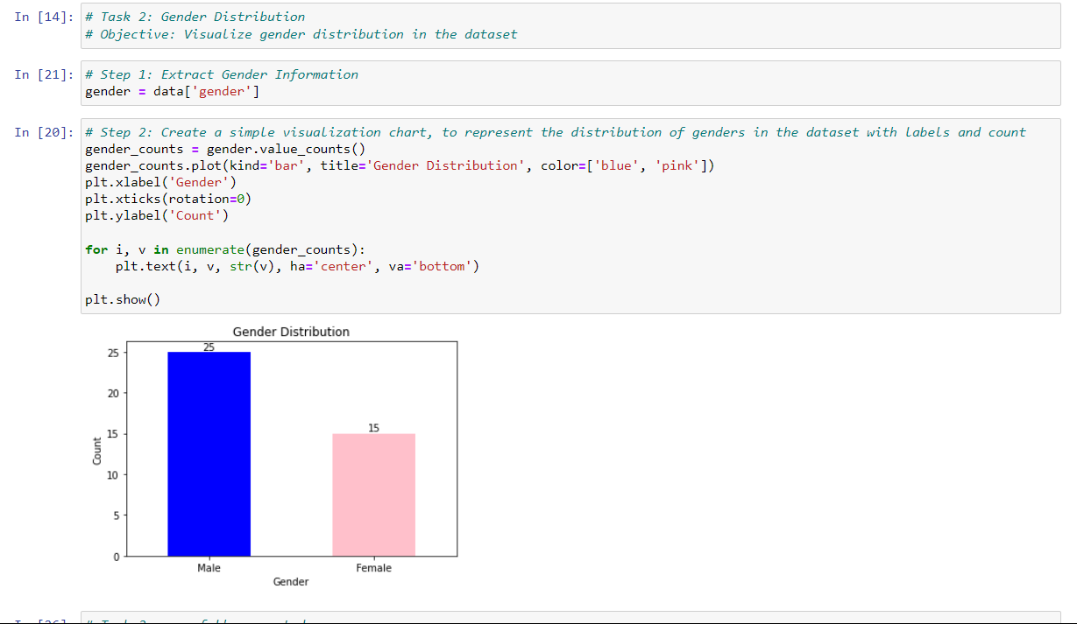
Task 2: Gender Distribution
Objective: Visualize gender distribution in the dataset

